Slide 1
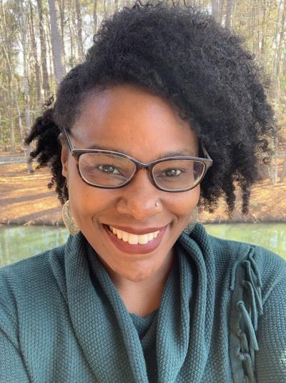
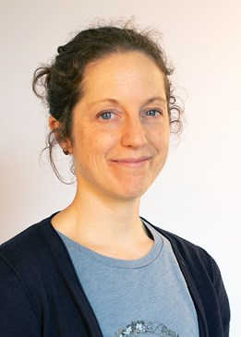
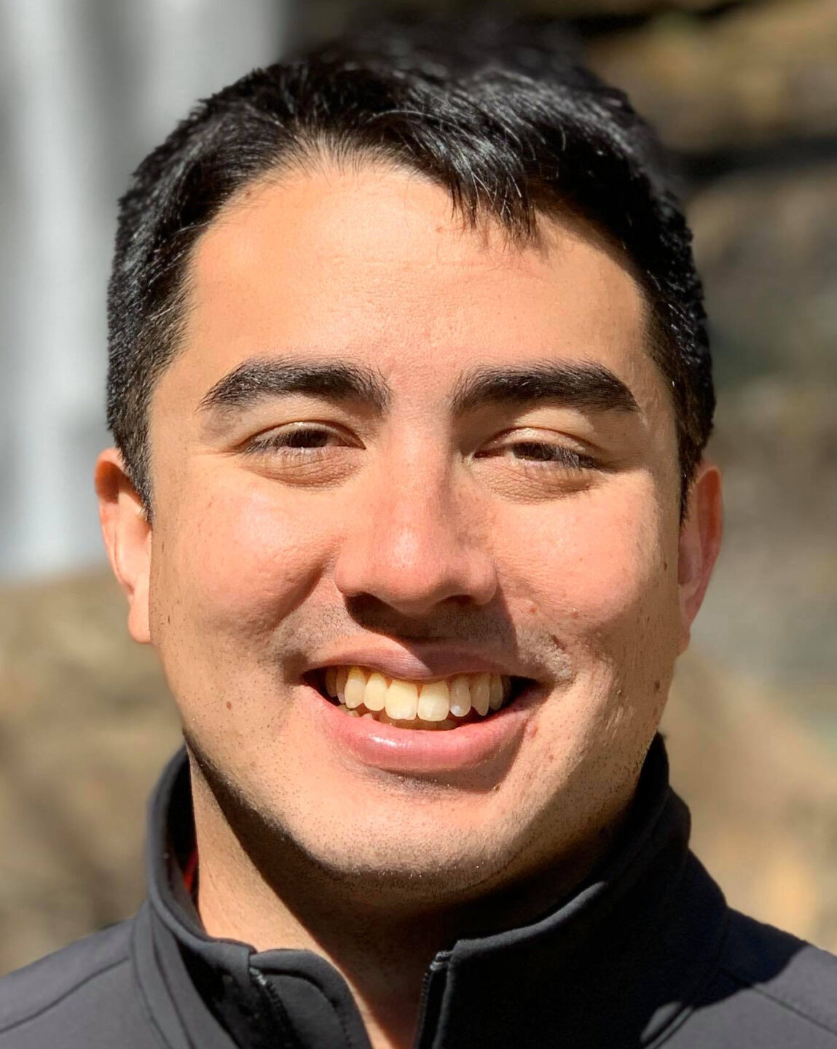
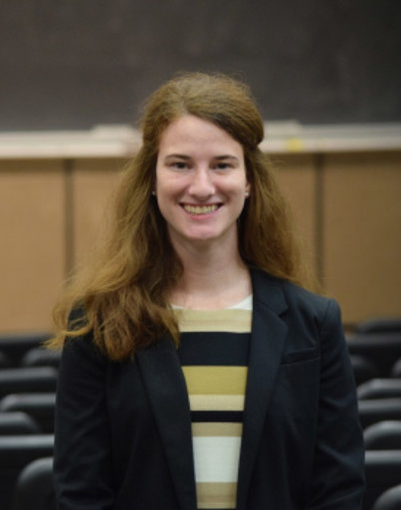
Finding non-academic jobs: A conversation with Natural Resources Social Scientists
Guest speakers:
Dr. Janae Davis, Southeast Conservation Director, American Rivers
Dr. Rose Keller, Research Scientist, Norwegian Institute for Nature Research
Dr. Jennifer Dunn, Regulatory Manager, Eco-Energy
Dr. Ben Lowe, Executive Director, Executive Director, A Rocha USA
Moderator: Dr. Mysha Clarke, Chair, IASNR Professional Development Committee

